Slide 1
Gam102 Assets
Properties
Notes:
Music on intro, popular track from a game

Slide 2
Overview
In this session you will be introduced to importing and setting up assets for production.

Slide 3

Task!
ShaderGraph
Open Unity
Add the package “shader graph”
Create a new scene and create a ground plane
Download a 3D model from any source and import it into unity (sketchfab ect)

Slide 4
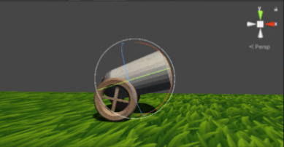
Prepare
Open Unity
Add the package shader graph
Create a new scene and create a ground plane
Download a 3D model from any source and import it into unity
Preparing models to work efficiently in engine
Changing the pivot points
Changing the scale
Fixing material issues
Prefabs are key here

Slide 5
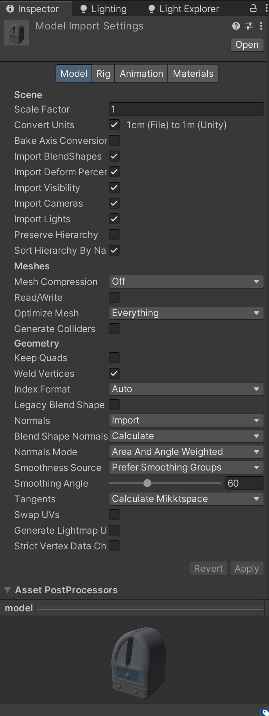
Import settings
Open Unity
Add the package shader graph
Create a new scene and create a ground plane
Download a 3D model from any source and import it into unity
Unity Import
Change scale here!
Try to keep xyz scale at 1 on the transform
Generate UV lightmaps is useful for dirty modelling
Read the unity import information for more guidance
Update a mesh in Unity by replacing it in the file explorer

Slide 6
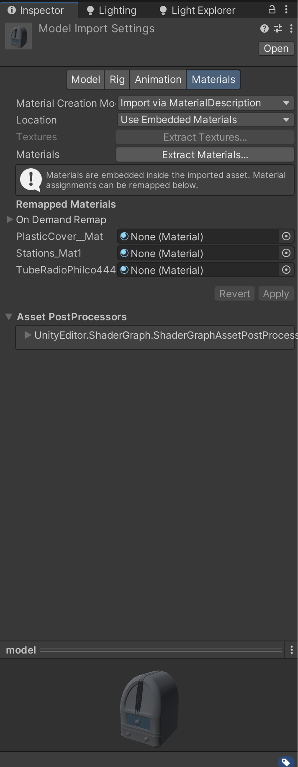
Task!
Textures
Materials
Using the models import settings extract the material/s
Reapply textures to the new materials slots
Normal map will prompt you to fix, click yes
Some textures won't fit into the slots, we will need to create new shaders.

Slide 7
Why cant I use some textures
Using the models import settings extract the material/s
Reapply textures to the new materials slots
Normal map will prompt you to fix, click yes
It’s common practice to embed grayscale images for roughness, metallic, ao, height ect into the alpha channel of an image, sometime images may even combine a different grayscale image into RGBA

Slide 8
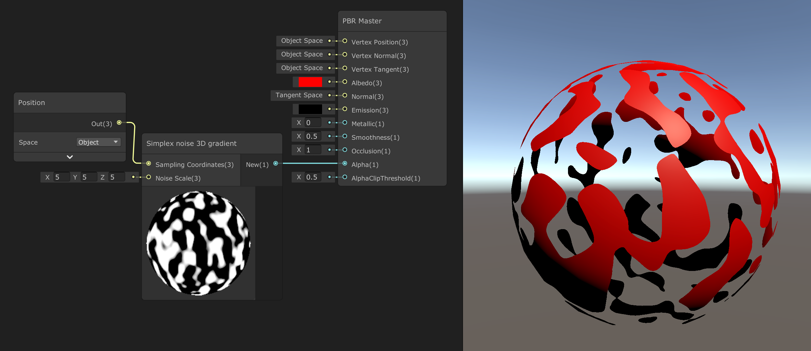
Shader Editor
Using the models import settings extract the material/s
Reapply textures to the new materials slots
Normal map will prompt you to fix, click yes
Shader editor is a great tool for creating node based scripted shaders akin to Unreals (just not as refined)

Slide 9
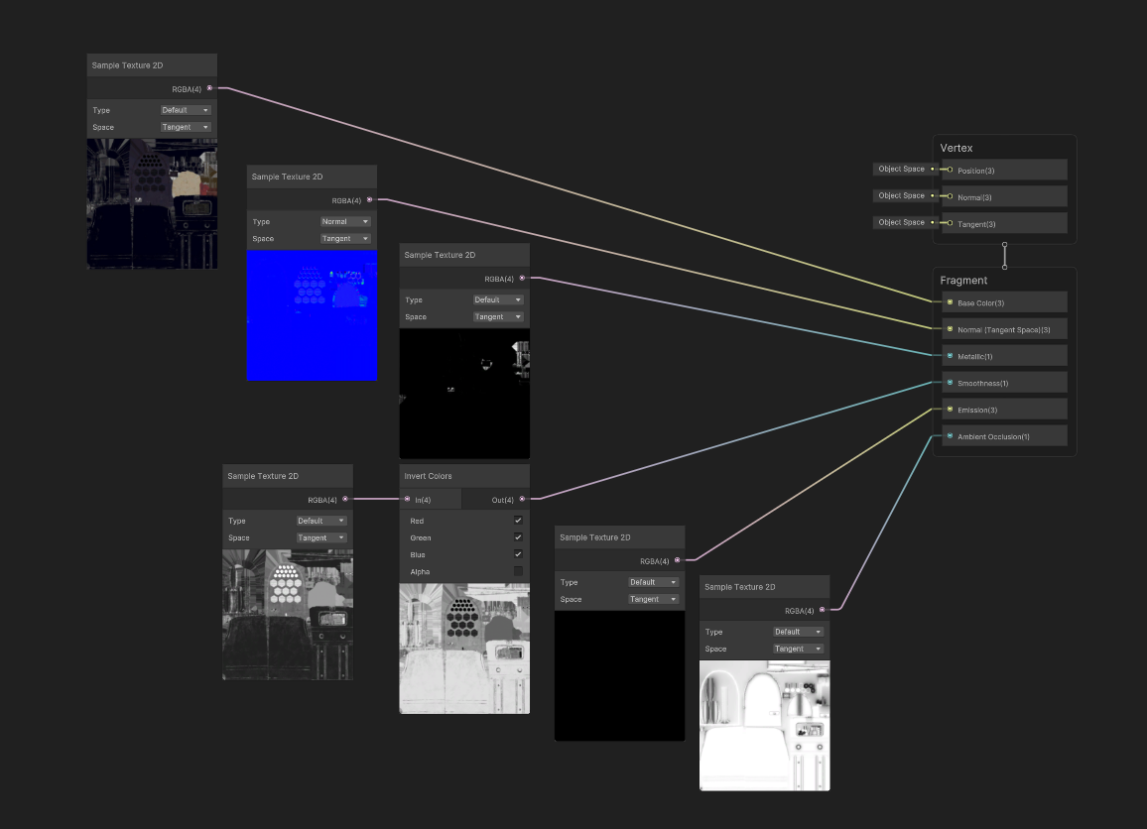
Task!
Shader Graph
Shader Basics
Create a new builtin lit shader graph
Using shader graph create a basic metal rough shader
Apply it to your mesh

Slide 10
It’s a bit limiting!

Slide 11
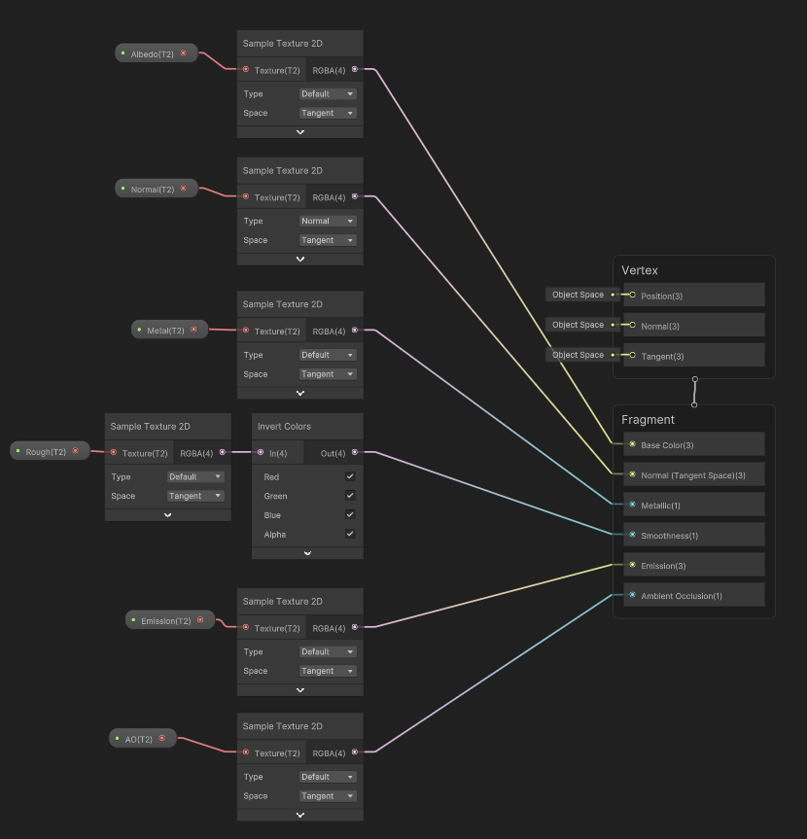
Task!
Shader Graph
Shader Basics
Expose the texture slots as parameters
Add the textures back in the material editor

Slide 12
Lets add some additional controls

Slide 13
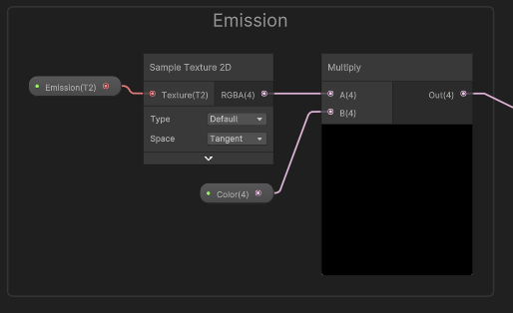
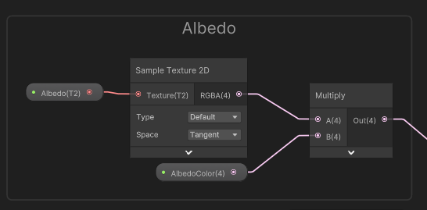
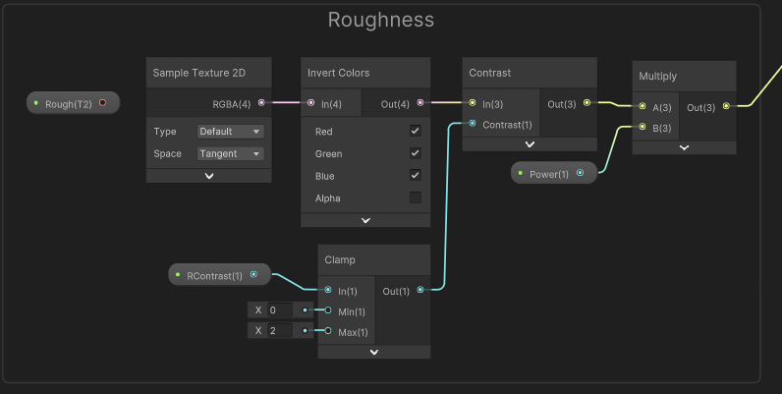
Task!
Shader Graph
Shader Basics
Add the colour input nodes back into the shader
Add additional contrast and power control to roughness
Finish setting up the model

Slide 14
Add the colour input nodes back into the shader
Add additional contrast and power control to roughness
Finish setting up the model
Optimization
If your model requires opacity, it may be more cost effective to create a new shader
If your model requires two sides faces make a new shader
Don’t try to make a god shader

Slide 15
Prefabs
Prefabs
Variant
Prefabs are one of the best features of Unity
Imported models are considered model prefabs and are read only, they are limited but may do the job
My preference is make everything a prefab
Prefabs can also be nested inside of other prefabs creating additional control

Slide 16
Task!
Nested Prefabs
Create a new prefab variant of your asset
Place this in the scene several times (Notice the pivot point is now set)
Open the prefab in the scene and delete or change one thing, all instances will now update and change
Revert this by opening the prefab in the project window
Create a new prefab and nest it into the original
Apply this to all objects
Now change something on the new prefab and see it change

